Slide 1
PhD recap
Structure–Activity Relationships for
Carbonyl Photolysis
Keiran Rowell - Feb 14, 2020

Slide 2
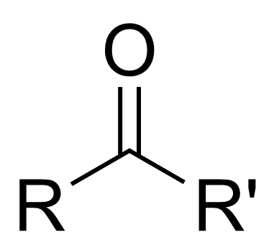
Introduction to Carbonyl Photolysis
Chapter 1

Slide 3
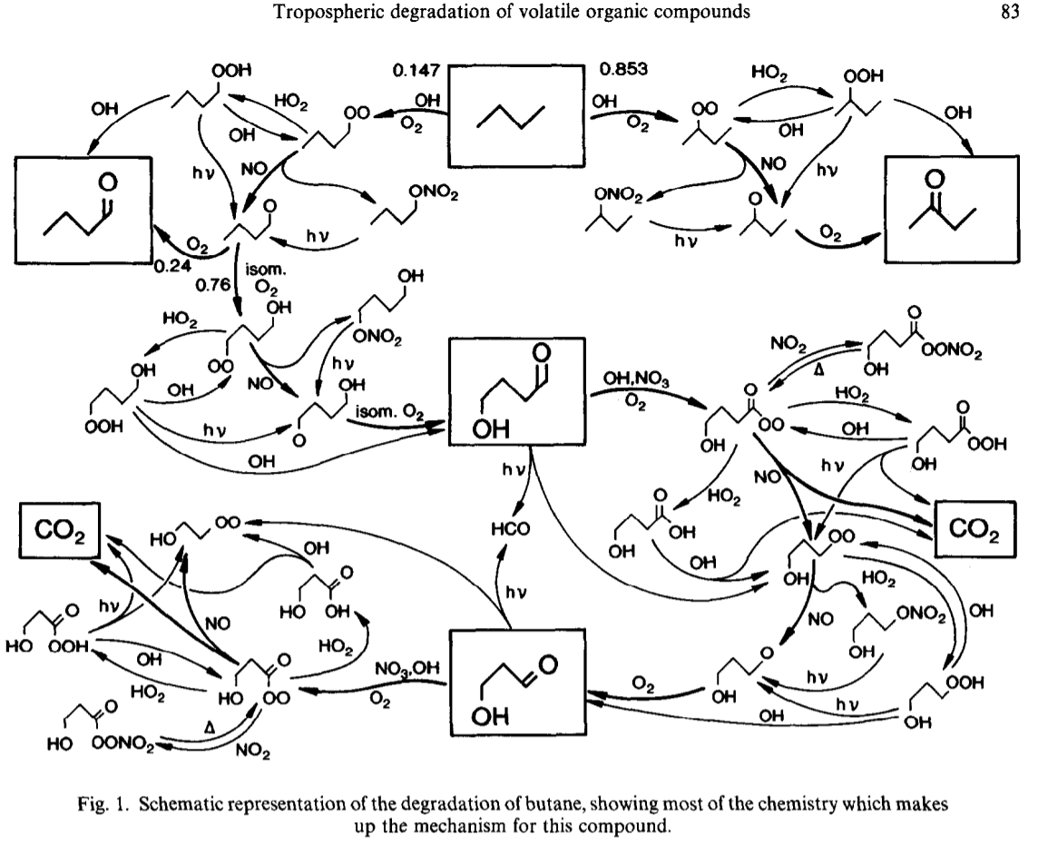
Carbonyls in the Atmosphere
Jenkin M., Saunders S., Pilling M., Atmospheric Environment, 1997, 31, 81-104
The atmosphere is highly oxidising
► Volatile organic compounds (VOCs) emitted by industrial & biogenic
► Carbonyls produced on all VOC degradation pathways to CO₂
►100s of different carbonyls
► Larger biogenic carbonyls can have complex structures
Models approximate w/ generic rules!
Notes:
Generic rules:
-Butanal NTI for all linear aldehydes
-iso-butanal (2-methylpropanal) for all a-branched carbonyls
-methacrolein equal value for all enals NTIa & NTIb
-butanone for all ketone NTI
-MVK for all enone NTI
-methylglyoxal for all dicarbonyl aldehyde NTIa
-diacetyl for all dicarbonyl ketone NTIa
Table 4 Jenkin et al 1997
Okay the plot on the right is delibrately complex. It’s there to illustrate that for a single organic compound, butane, a wide range of carbonyls are formed in signficant amounts

Slide 4
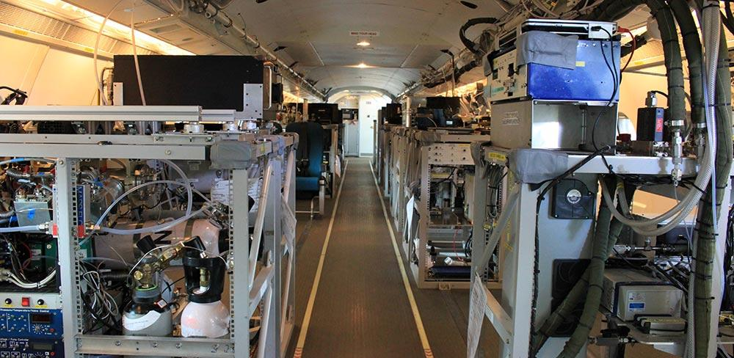
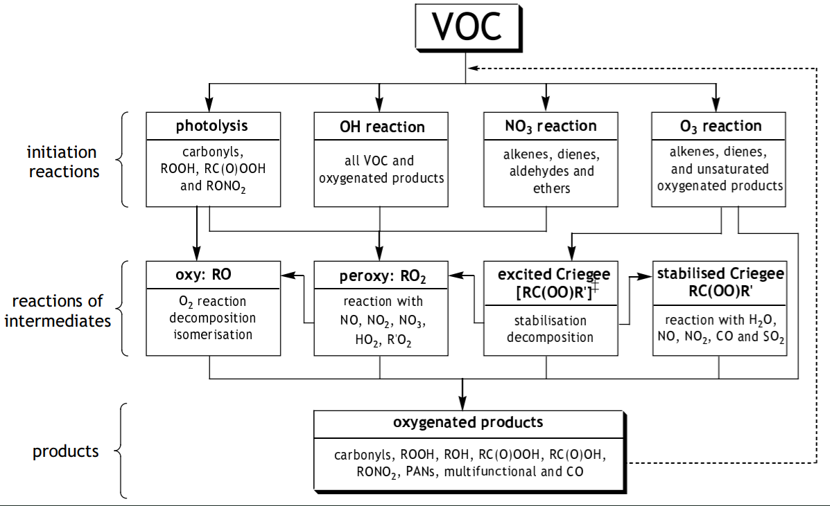




Modelling atmospheric chemistry
Image left: FAMM Website, Instrumentation - FAAM, faam.ack.uk/the-aircraft/instrumentation/, Facility for AIrborne Atmospheric Measurements (FAAM), (visited 21 Jan 2019)
Scheme right: Saunders S., Jenkin M., Derwent R., Piling M., Atmos. Chem. Phys., 2003, 3, 161
MCM Website, The Master Chemical Mechanism v3.3.1, mcm.leeds.ac.uk/MCM, Rickard A., Young J., Pilling M., Jenkin M., Pascoe S., Saunders S., et al., (visited 21 Jan 2019)
Field measurements
Computer modelling
Notes:
‘Understanding atmospheric chemistry’
Ballon picture, concentration output
Image o the outpout, you ut the mechanism later

Slide 5
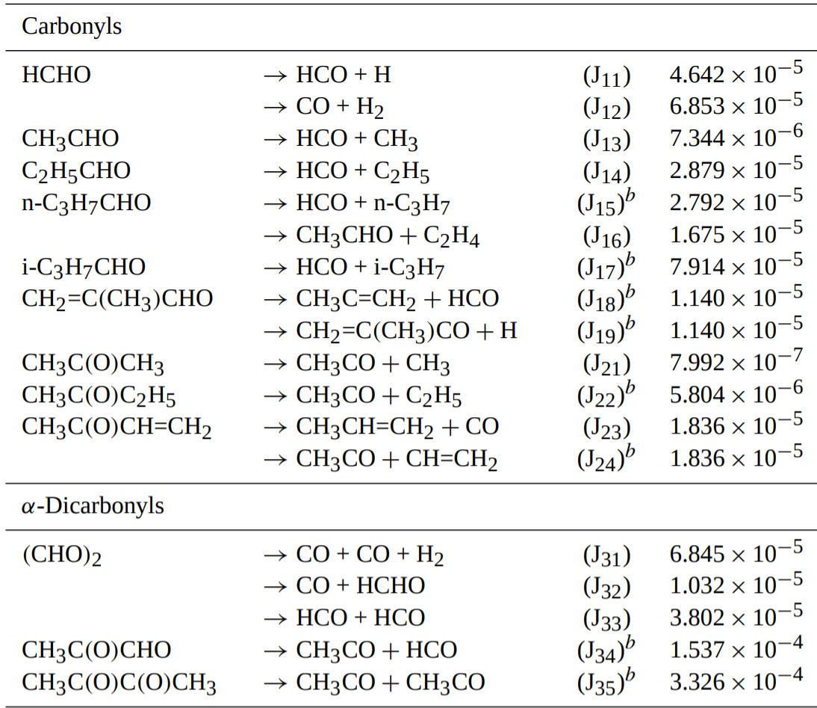
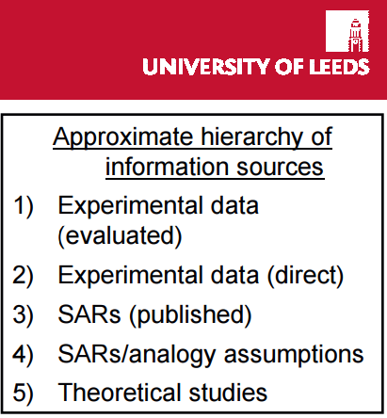
Saunders S., Jenkin M., Derwent R., Pilling M., Atmos. Chem. Phys. 2003, 3, 161-180
Rickard, Pascoe, Jenkin, Pilling, Development of the Master Chemical Mechanism - [conference slides],
International Conference on Atmospheric Chemical Mechanisms, Davis, CA, December 6-8, 2006
Photolysis rate coverage in models is limited
Photoproducts
ID
Rate
Norrish I
Norrish II
Notes:
As you’ll see propanal only has 1 photolysis rate in the MCM
Add labels to columns
Add column titles

Slide 6
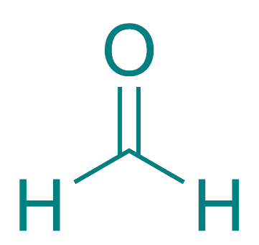
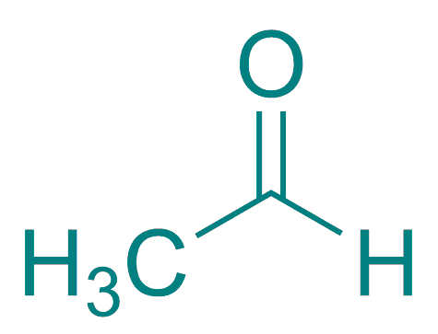
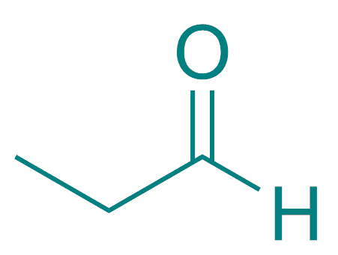
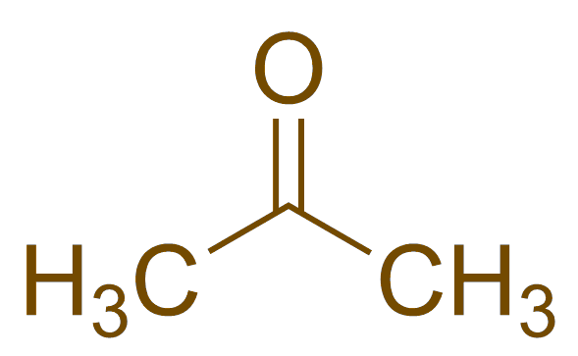
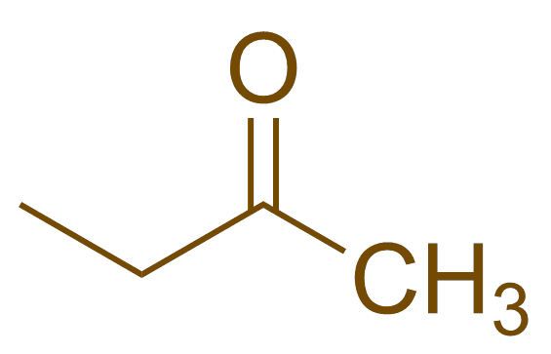
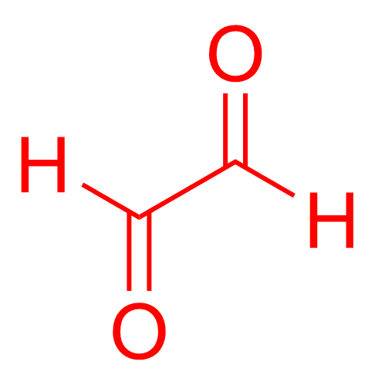
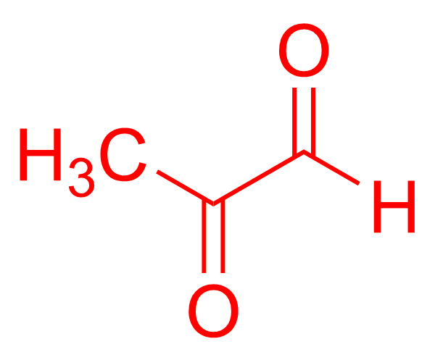
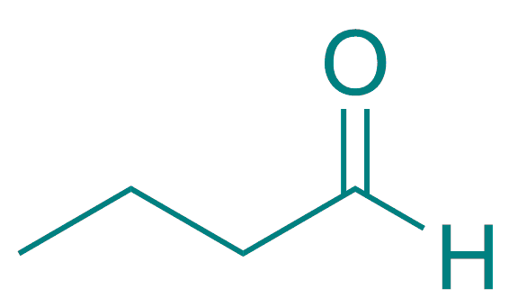
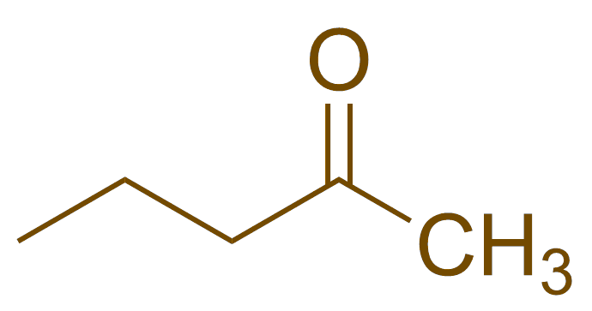
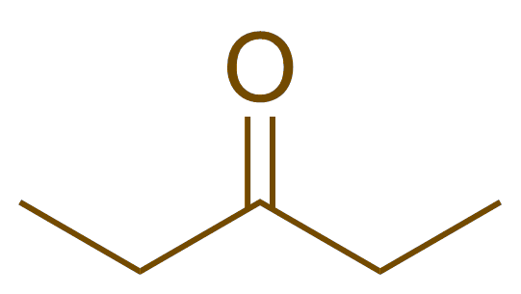
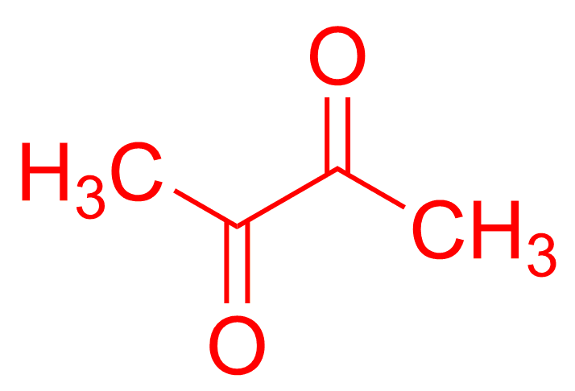
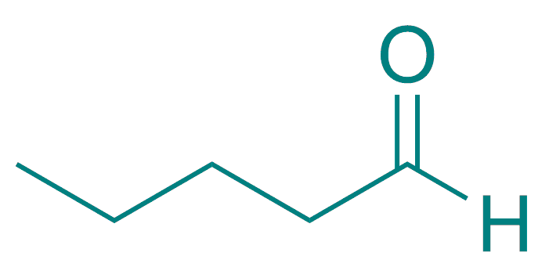
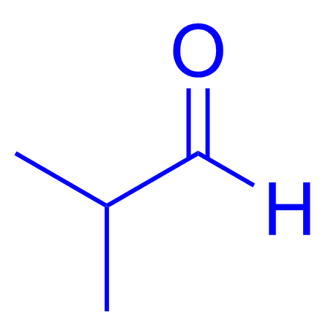
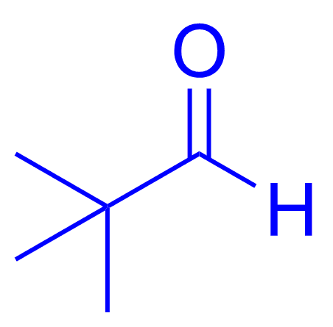
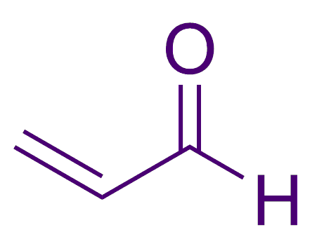
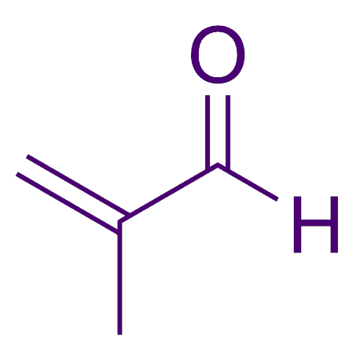
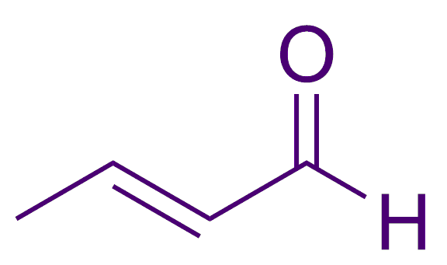
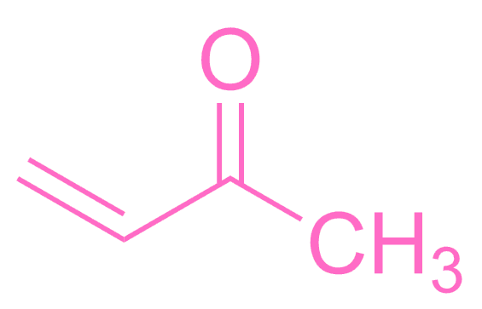
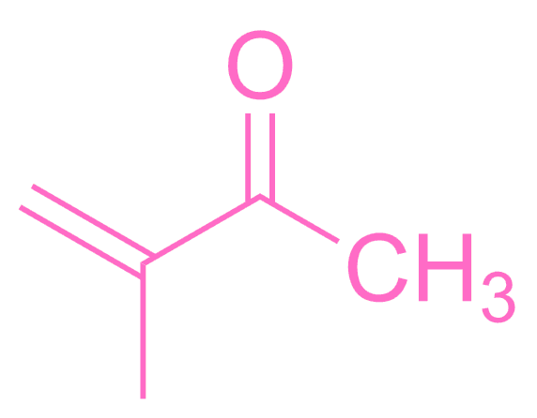
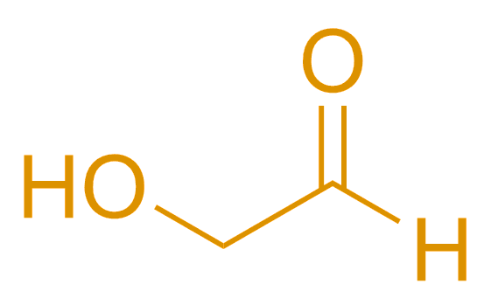
My carbonyl data set
Linear aldehydes
Ketones
Dicarbonyls
Branched aldehydes
Enals
Enones
Carbohydrate

Slide 7
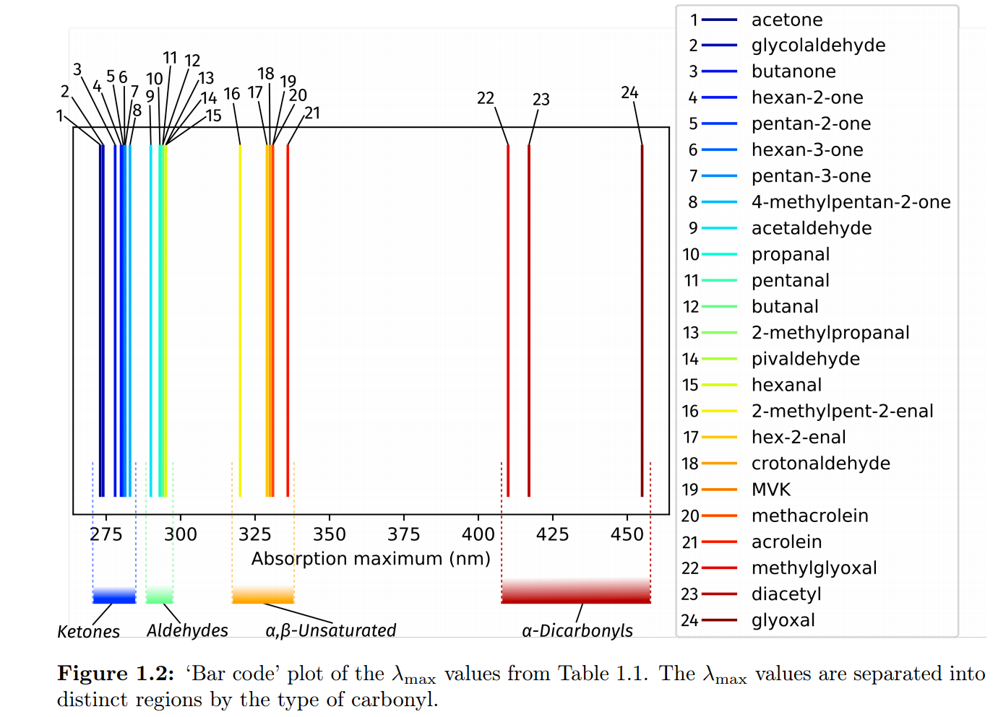
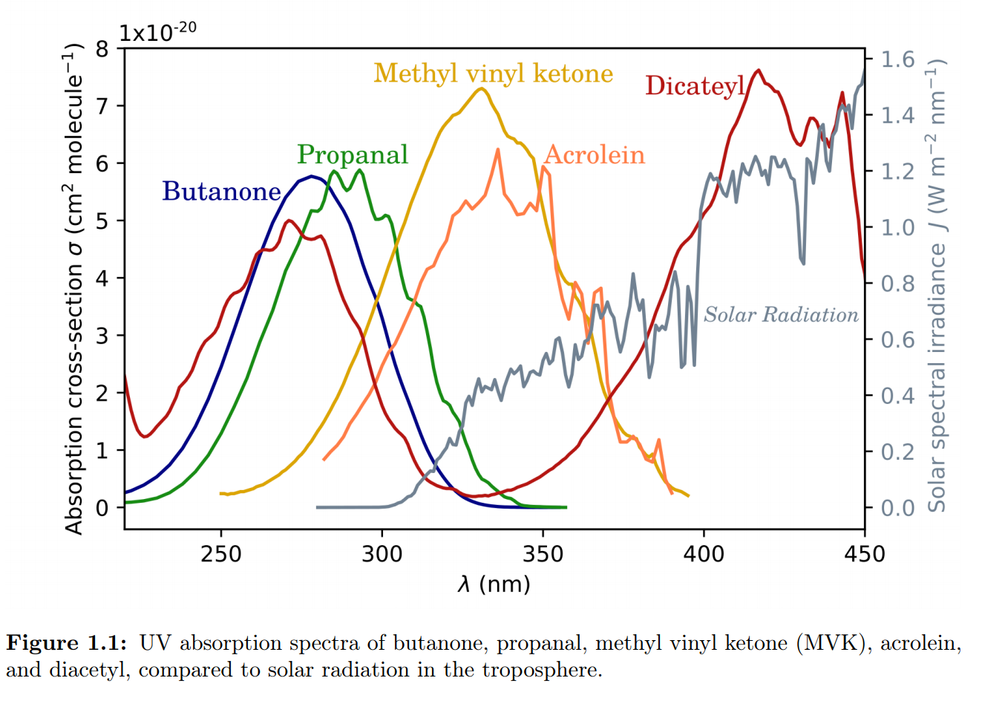
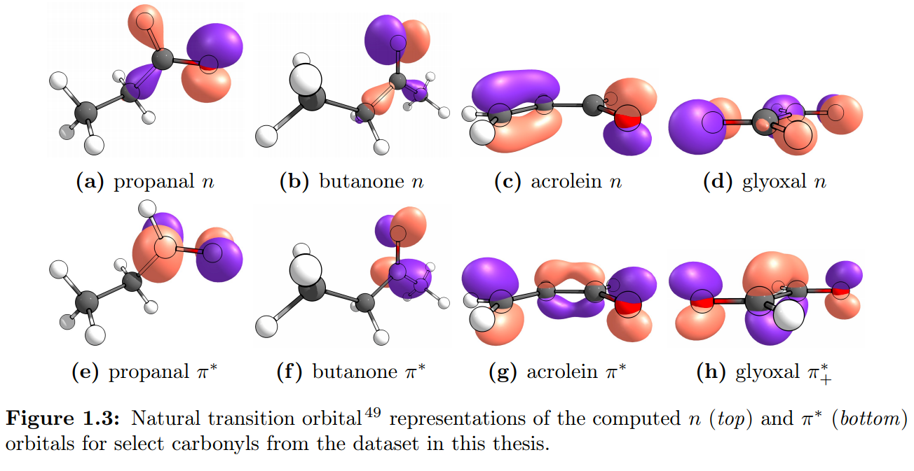
Photoexcitation of carbonyls

Slide 8
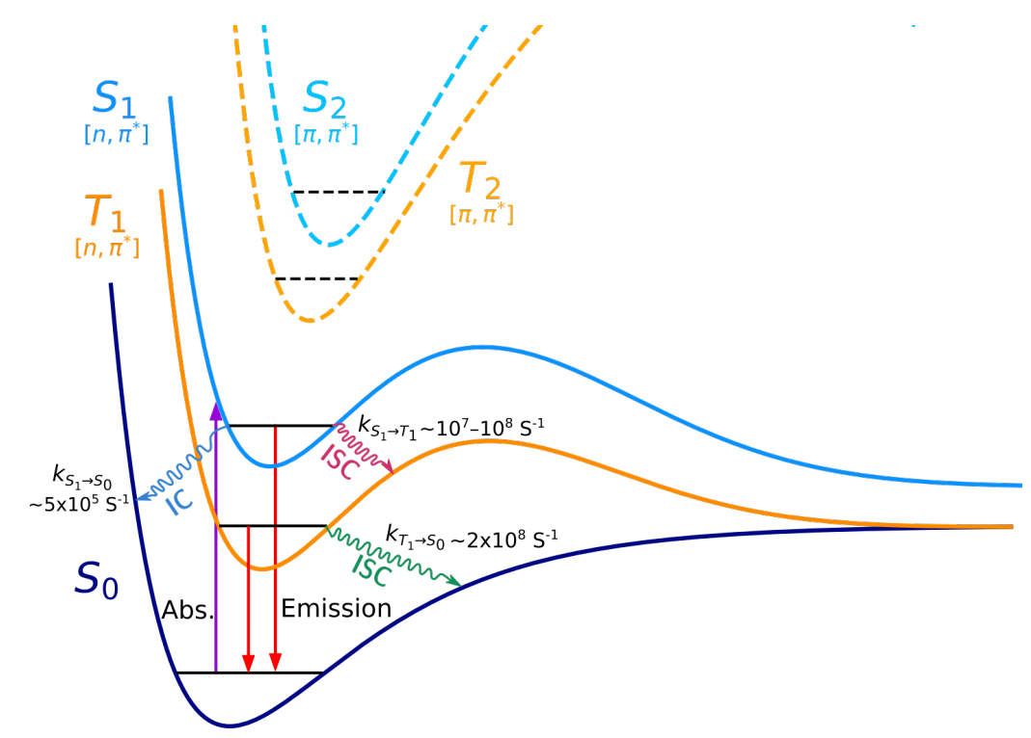
Electronic states
Corrigan M., Modelling the Photochemistry of Acetaldehyde, [Honours Thesis], UNSW, Nov. 2015
Lee S. H., Chen I. C., Chem Phys, 1997, 220, 175-189
Hansen D. A., Lee K.C., J. Chem. Phys., 1975, 63, 3272

Slide 9
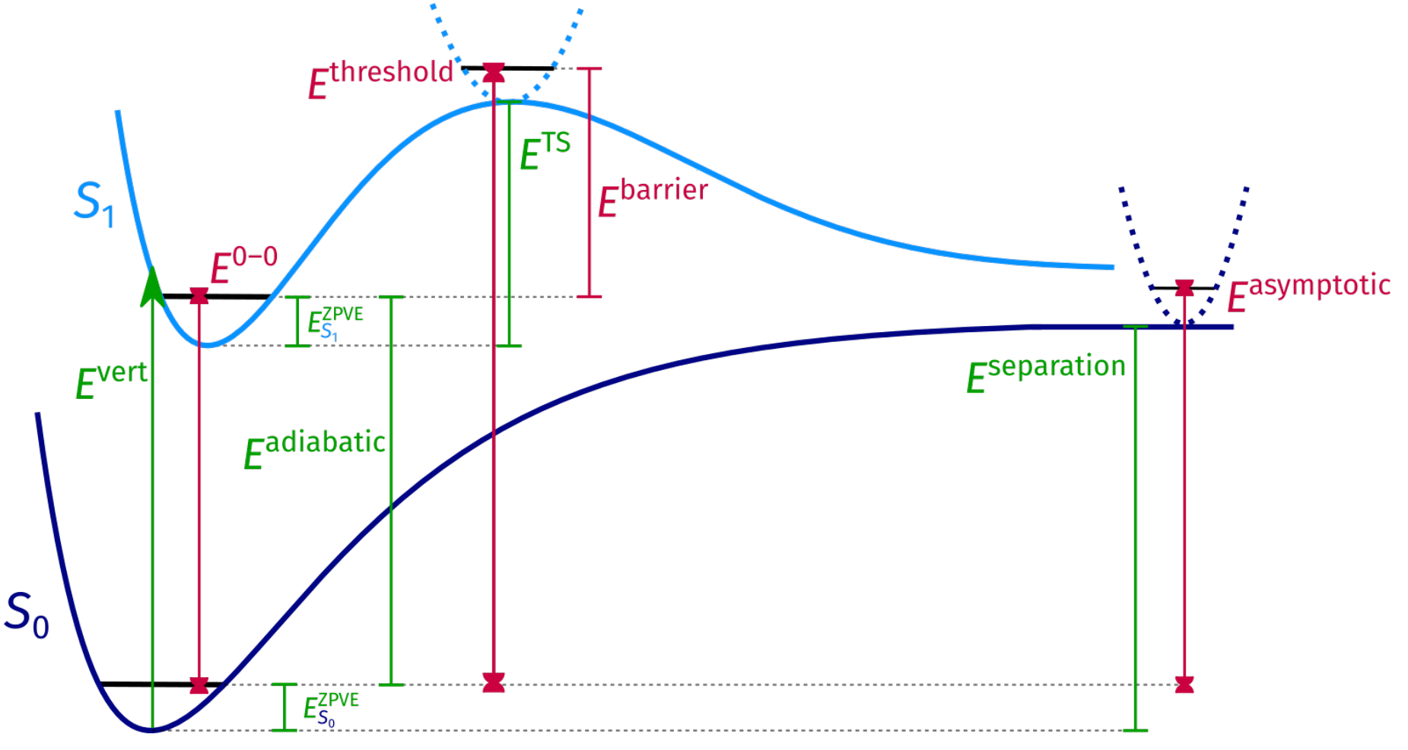
Calculating photolysis
Green = calculation
Red = experiment

Slide 10
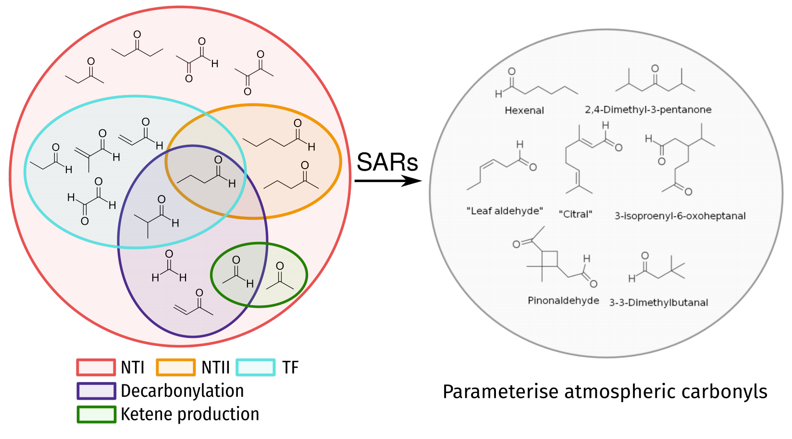
Aim: structure-activity relationships for photolysis
1) Pitts J., J. Chem. Ed., 1957, 34, 112-121
2) Nicol C., Calvet J. Am. Chem. Soc., 1967, 89, 1790-1798
3) Coyle B., Carless H, Chem. Soc. Rev., 1972, 1, 465-485
► 38 (20+18) carbonyls in dataset
► 3 states (S0, T1, S1)
► 10 types of reaction
► Method benchmarks
► Summary SARs
► No contemporary SARs^{1,2,3}
Future: apply SARs to
other atmospheric carbonyls

Slide 11
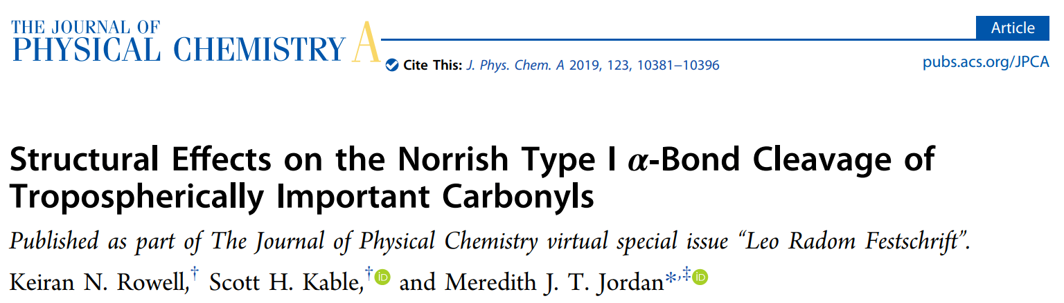
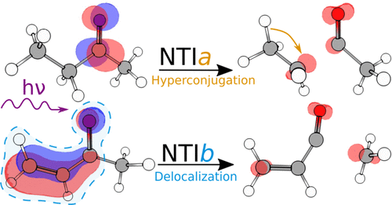
The Norrish Type I Reaction
Chapter 2

Slide 12
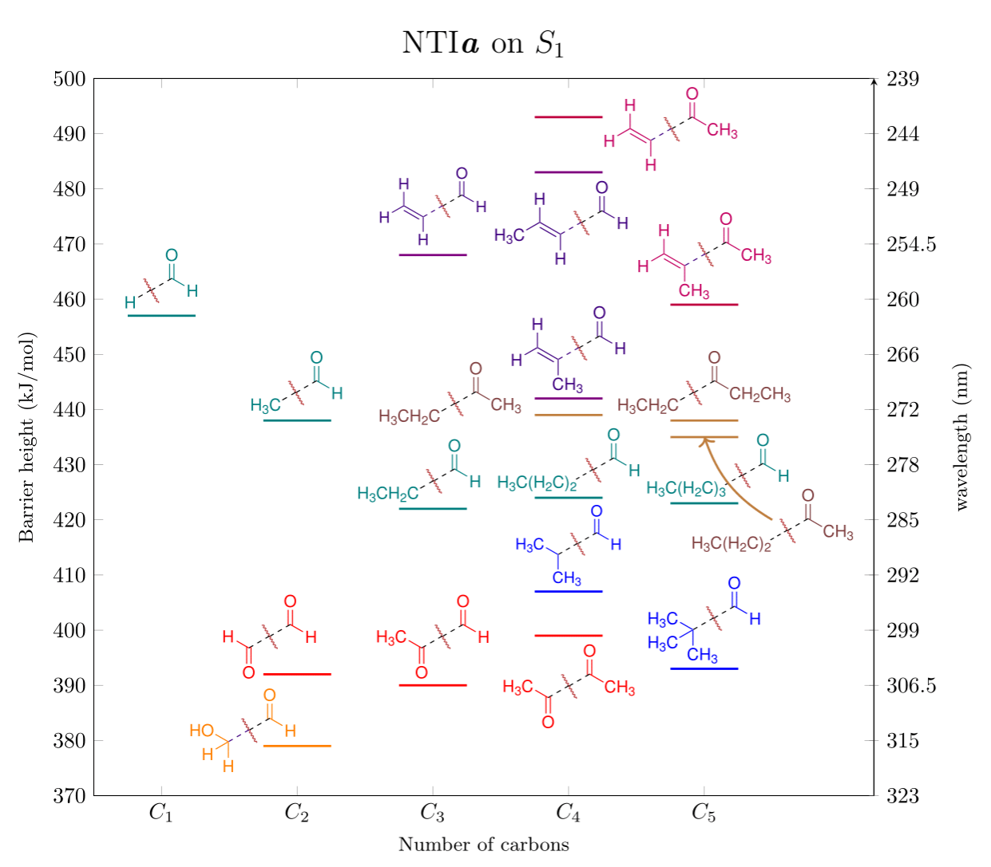
NTIa S₁ barriers
Method: RI-B3LYP/def2-TZVP
►Linear aldehydes & ketones:
⬩ S₁ barriers inaccessible (>400 kJ/mol)
⬩ Singlet invoked for unquenchable rxn
► S₁ can be ignored in atmosphere
⬩ Experiment actually seeing T₁ & S₀
400
300
►Barrier height explained by SARS
⬩ Particularly important for T₁ rxns
Notes:
Move this before T1, sand dismiss

Slide 13
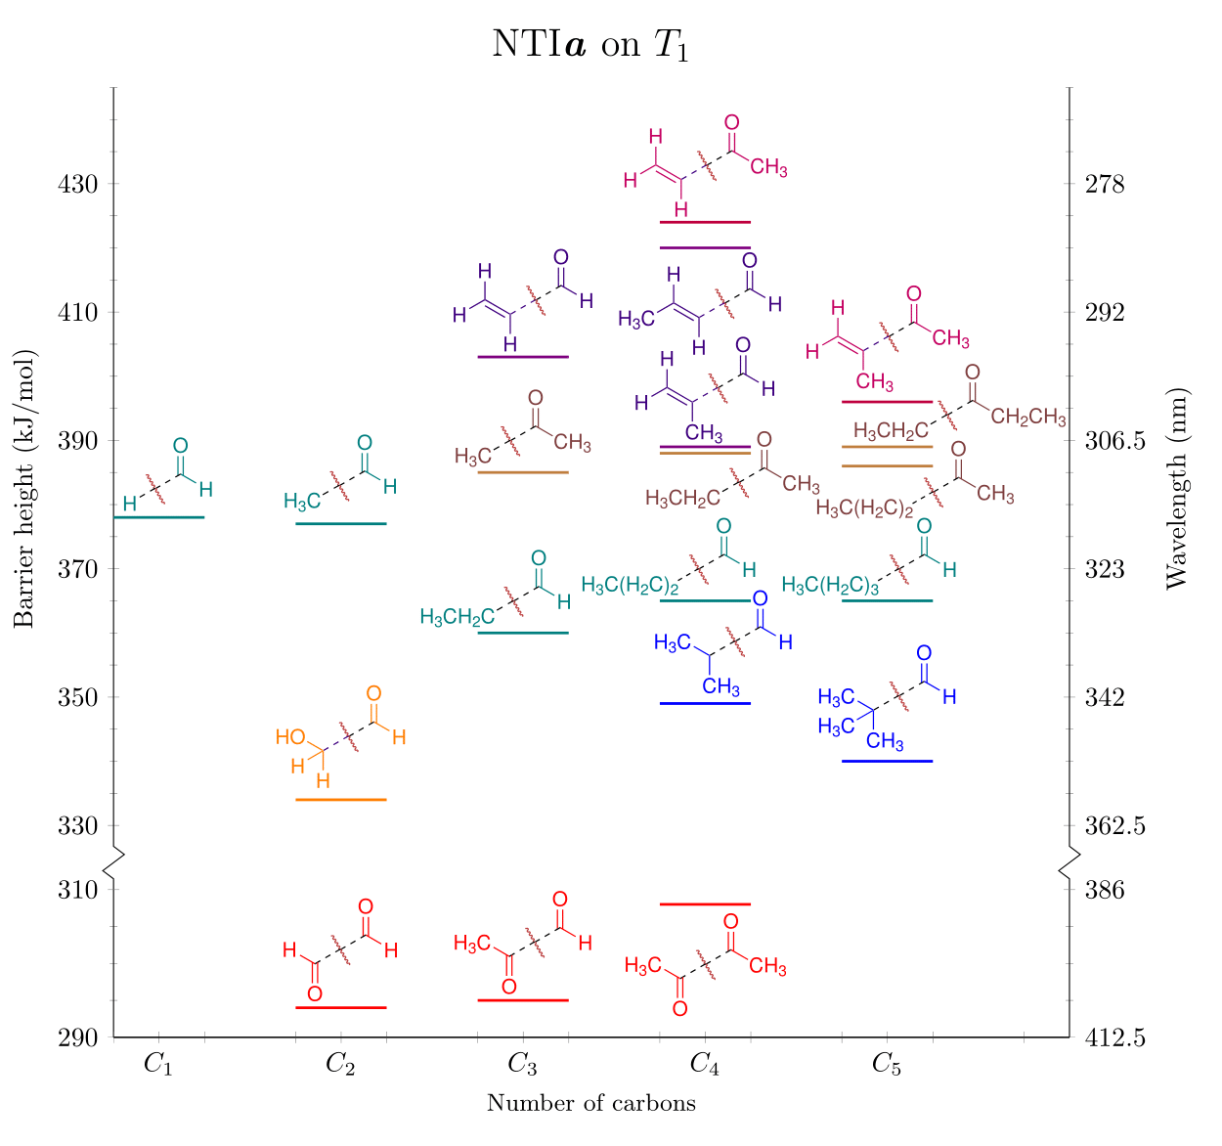
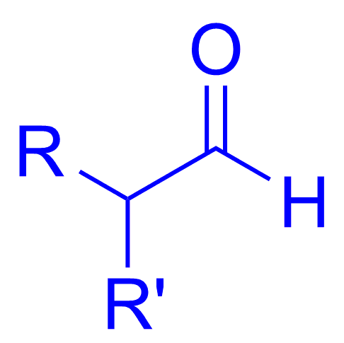
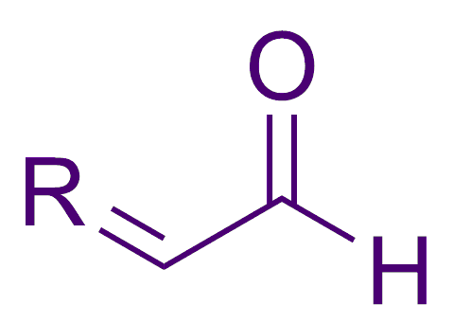
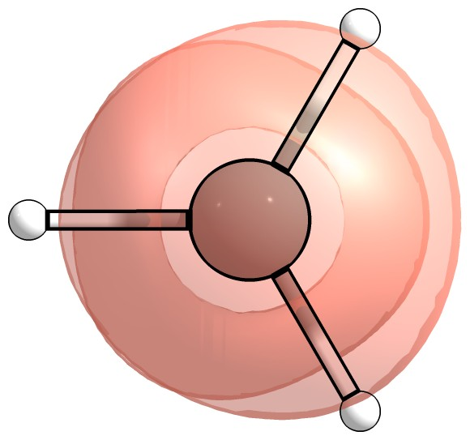
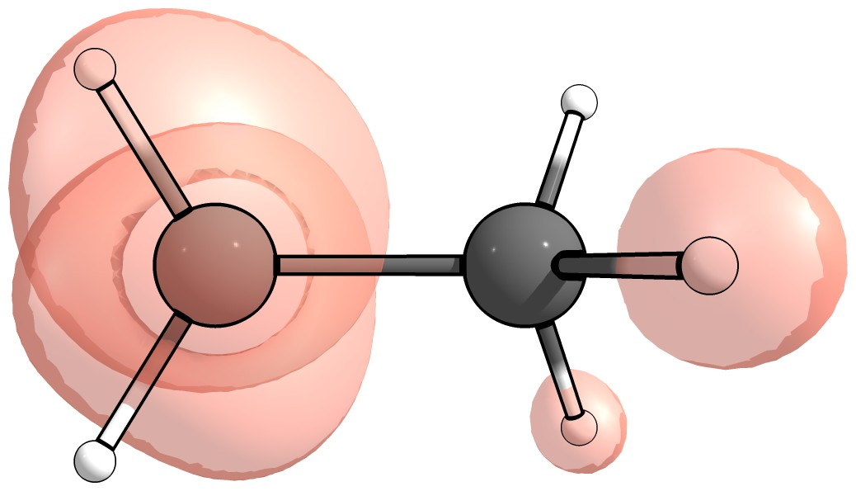
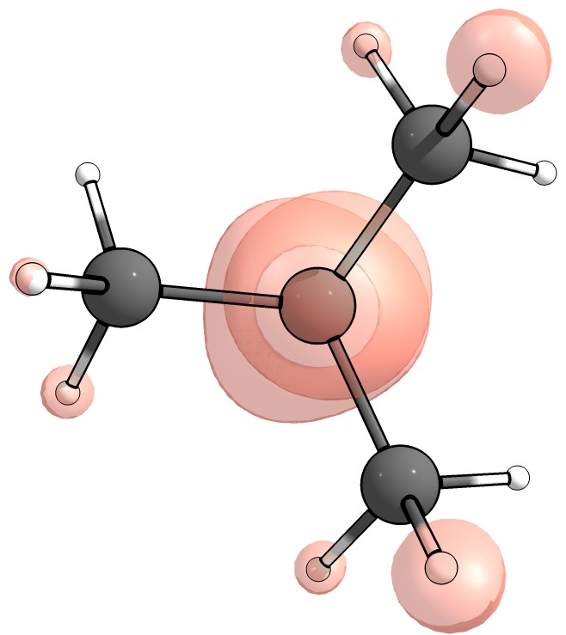
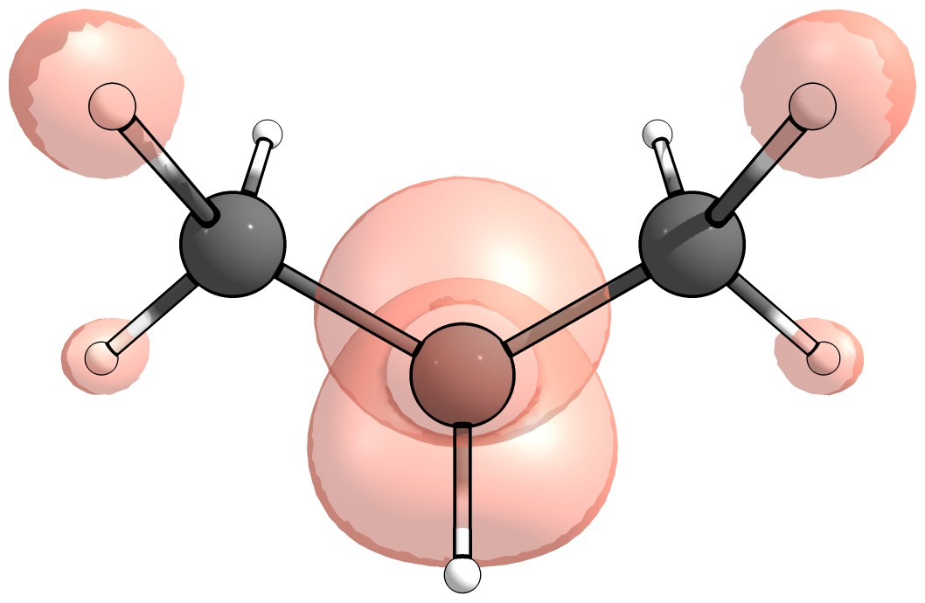
NTIa T₁ barriers
Method: RI-B2GP-PLYP/def2-TZVP
400
300
vs.
Branching
Conjugation
Notes:
Put 400 kJ/mol 300nm as highligthed points
Remove picture when putting dots, error bars. Benchmark theory?

Slide 14
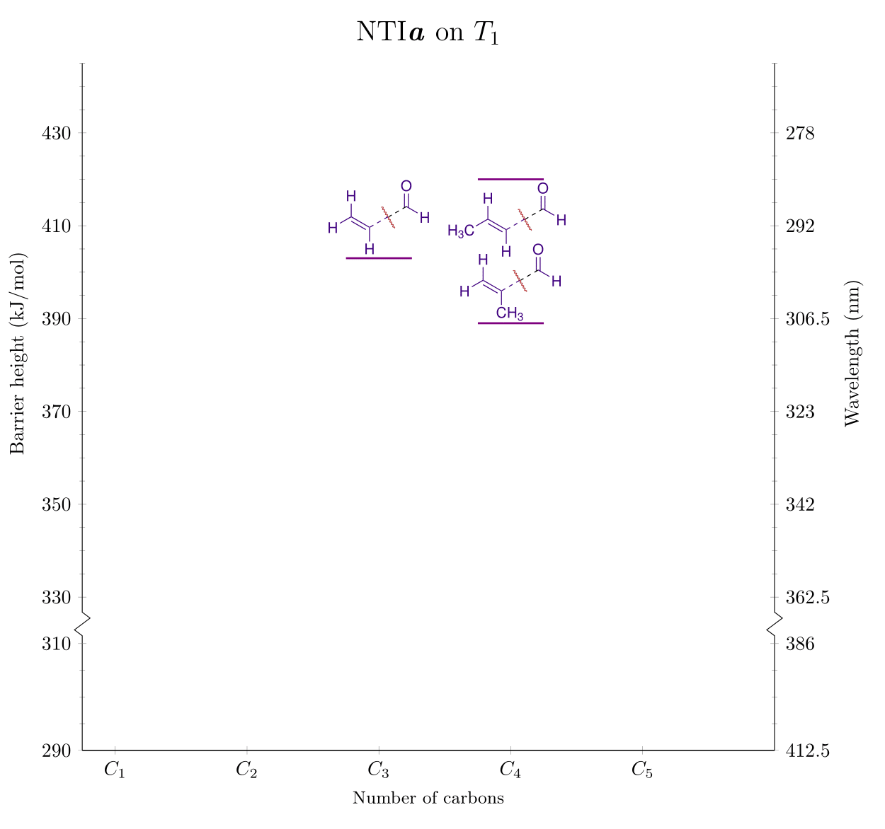
NTIa T₁ barriers
Method: RI-B2GP-PLYP/def2-TZVP
400
300
vs.
Branching
Conjugation
Notes:
Put 400 kJ/mol 300nm as highligthed points

Slide 15
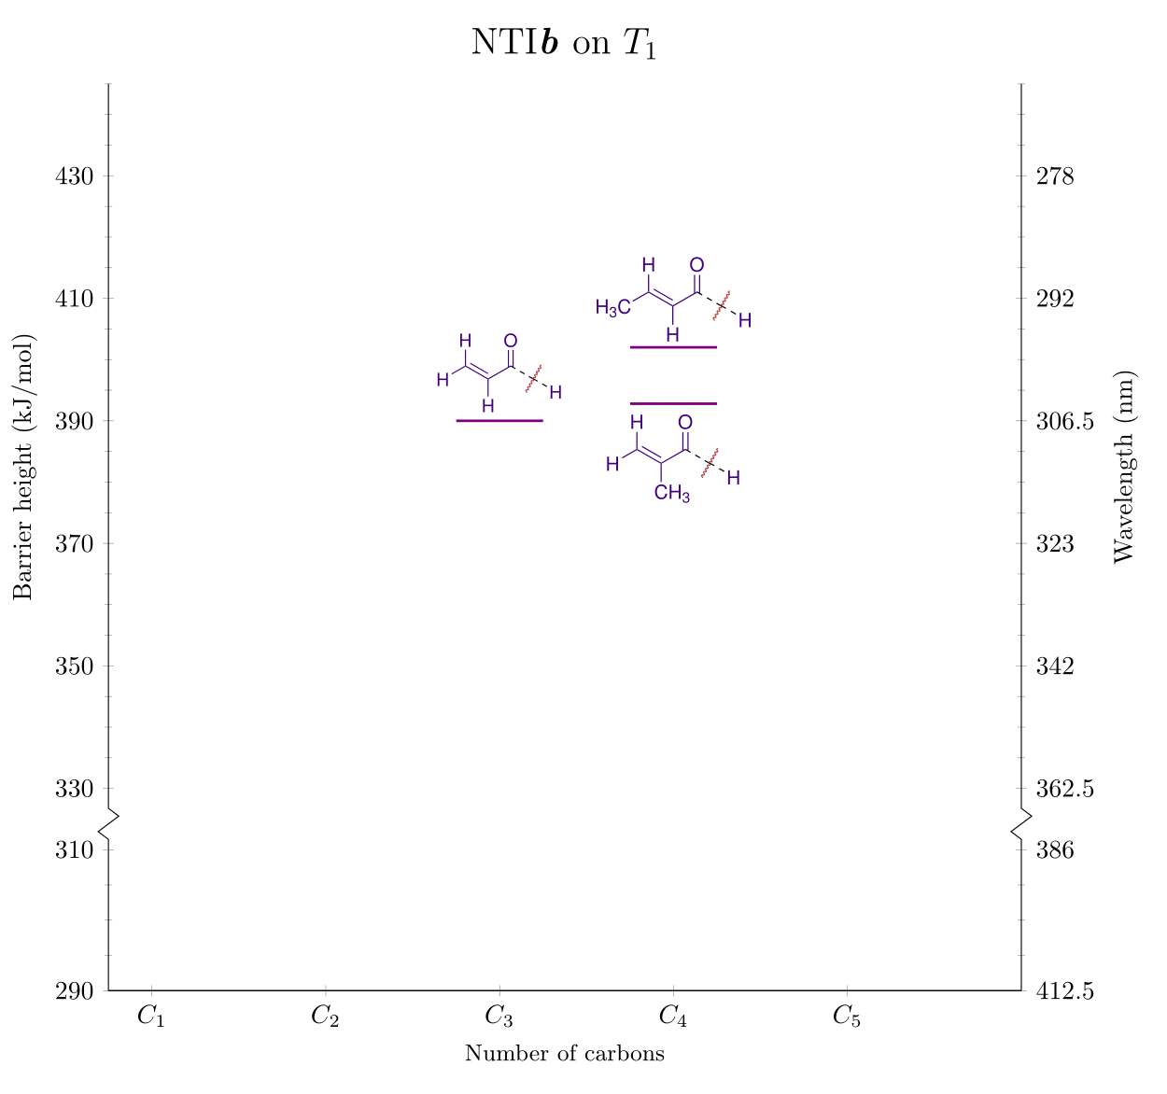
NTIb T₁ barriers
Method: RI-B2GP-PLYP/def2-TZVP
►If α,β-conjugated: cleave other bond
► Supported by FT-IR
⬩ H• source needed in acrolein expt.
⬩ Most enals negligible QYs
400
300
Notes:
Put 400 kJ/mol 300nm as highligthed points

Slide 16
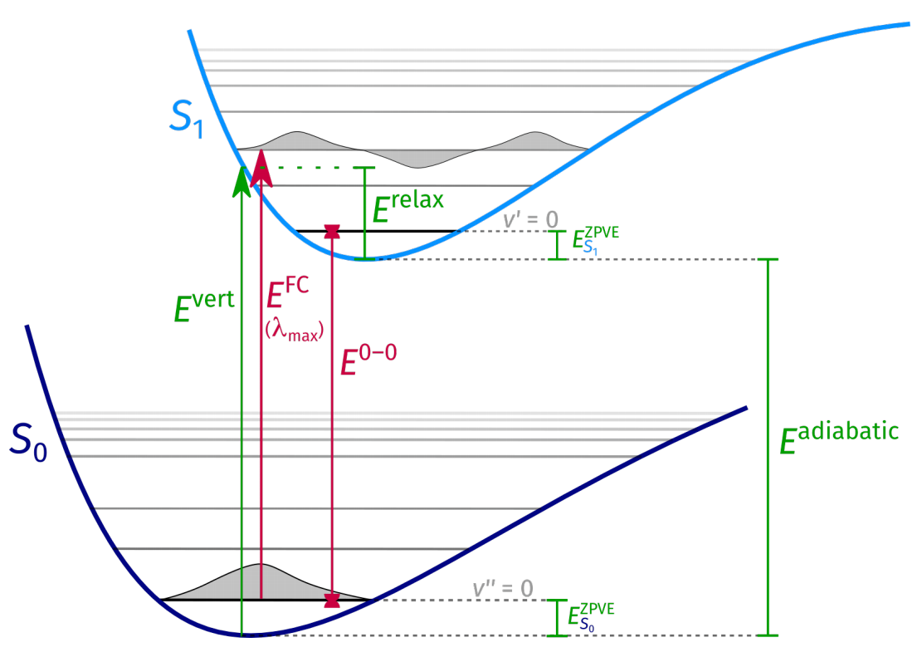
Vertical, Adiabatic, and 0–0 Excitation Energies
Chapter 3

Slide 17
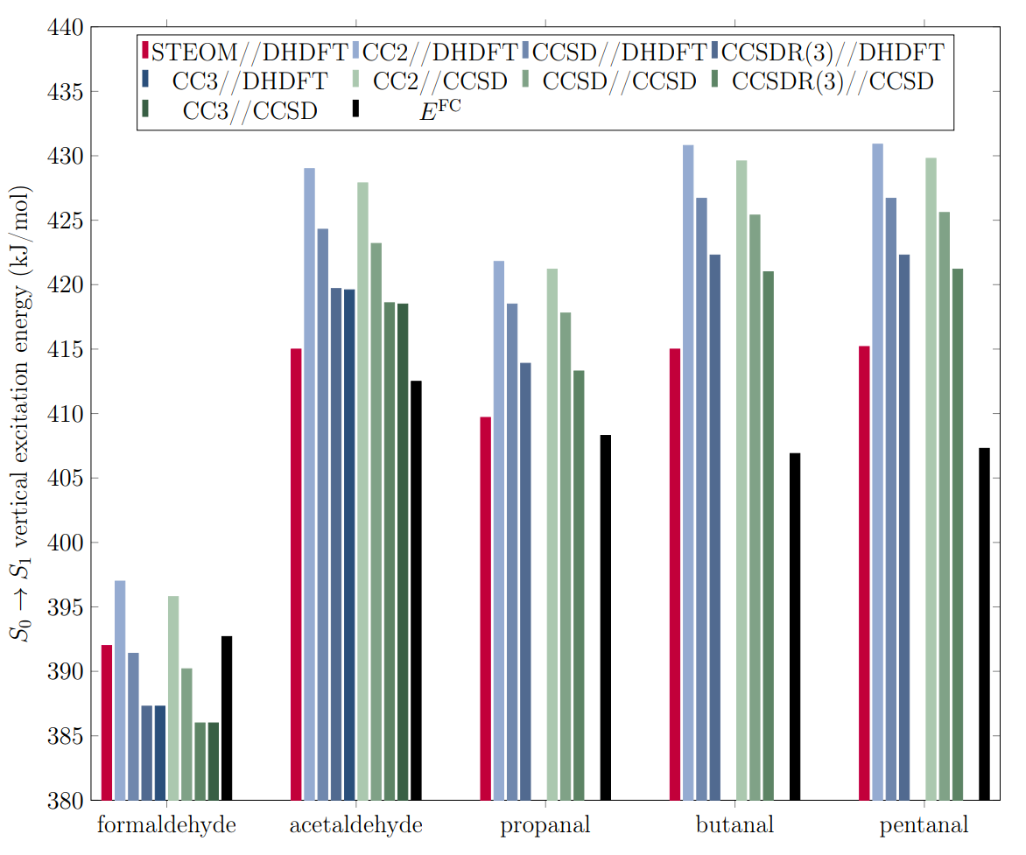
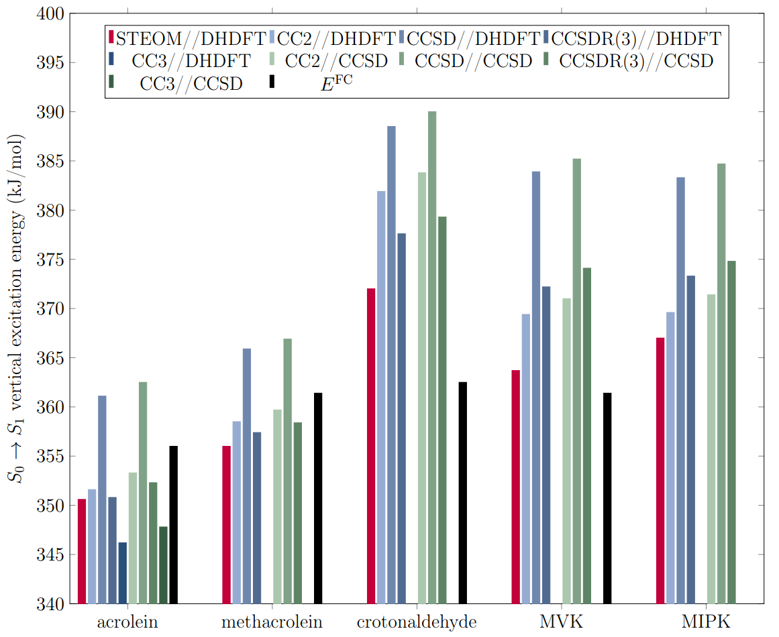
Vertical excitation energy calculations
Aldehydes
Enals

Slide 18
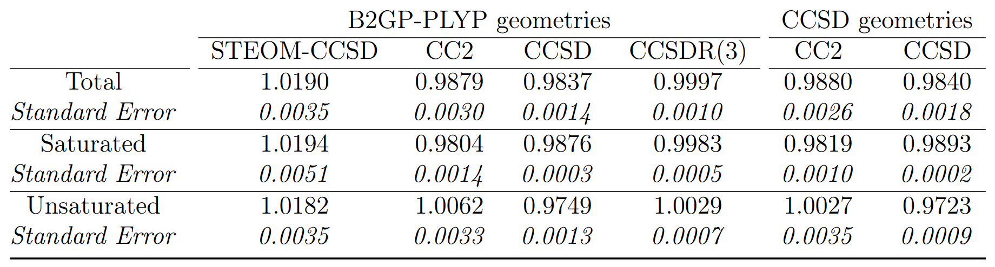
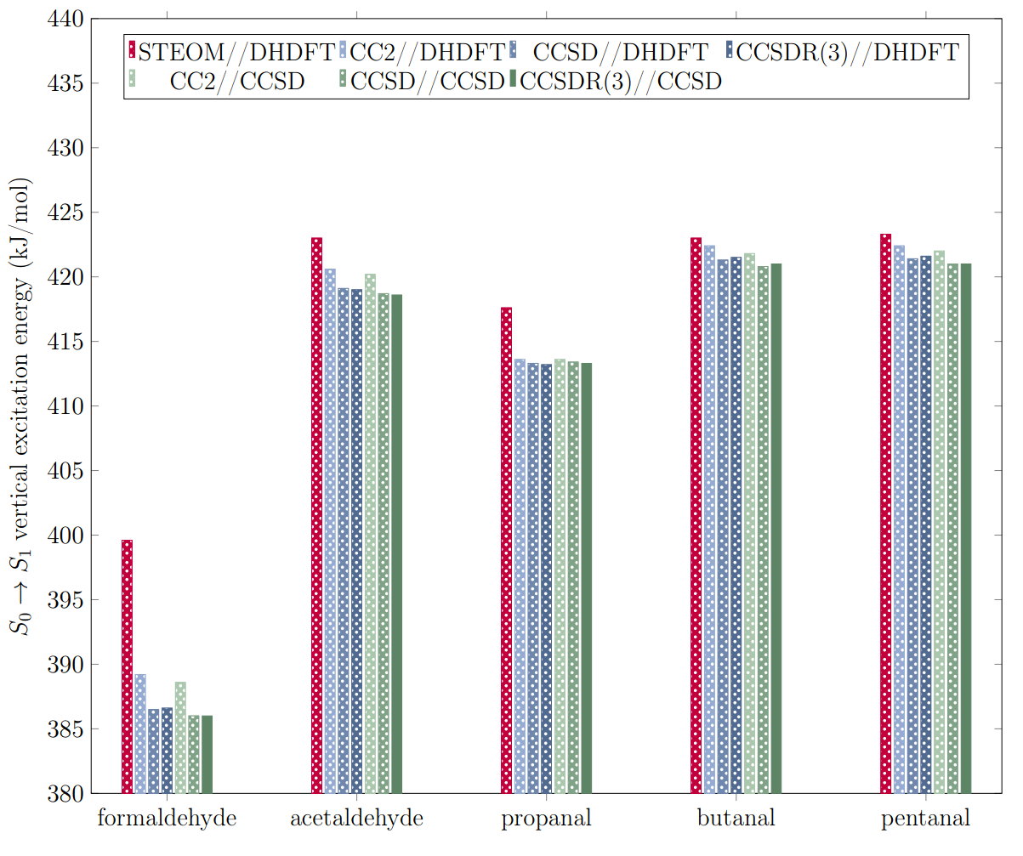
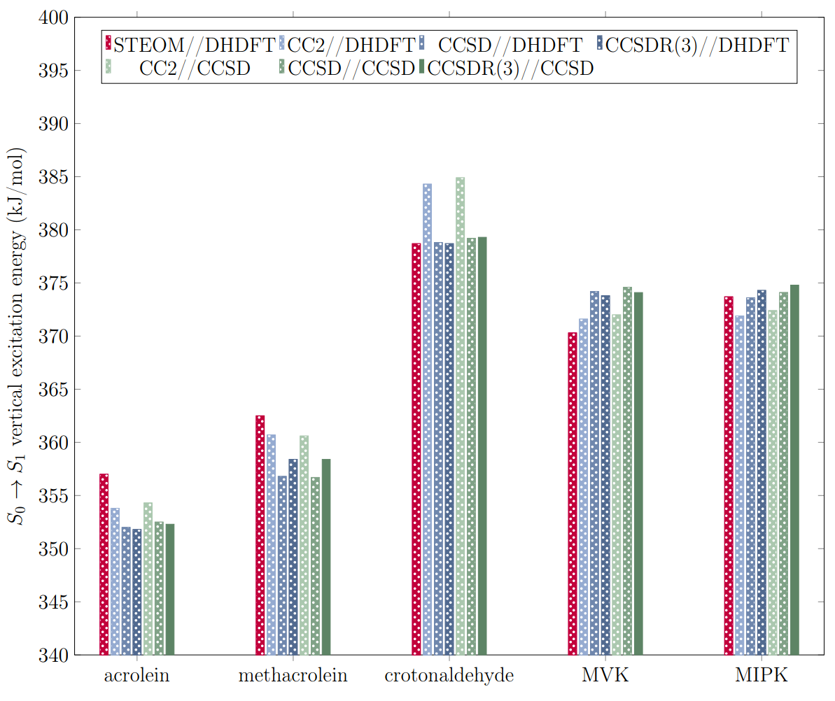
Scaled vertical excitation
E^{vert} scaling factors
Aldehydes
Enals

Slide 19


E^{0–0} protocols
Godunov I. A., Yakovlev N.N., J. Struct. Chem., 1995, 36, 238-253

Slide 20


The Norrish Type II Reaction
Chapter 4

Slide 21

NTII larger carbonyl dataset

Slide 22



T₁ (filled) and S₁ (open) NTII intrinsic reaction barriers

Slide 23


CASSCF calculations & S₁/S₀ conical intersection

Slide 24


NTII S₁and T₁ photolysis thresholds
NTII S₁
NTII T₁

Slide 25


Reaction on S₀?

Slide 26

Ground State Reactions
Chapter 5

Slide 27

Decarbonylation

Slide 28

Triple Fragmentation

Slide 29

Norrish Type III (ꞵ-H transfer)

Slide 30

H₂ loss reactions

Slide 31

Keto-enol tautomerisation
Shaw M., Sztáray B., Whalley L., Heard D., Millet D., Jordan M., Osborn D., Kable S., Nature Communications, 2018, 9:2584

Slide 32

Application of SARs to Carbonyl Photolysis
Chapter 6
Pinonaldehyde

Slide 33


Previous photolysis schemes
Uses “surrogates”
(no experimental data)
► Both “NTII” reactions same QY, hexanal
► Aldehyde NTIa QY from hexanal
►Ketone NTIa′ QY from butanone
► Poor surrogates: even though butanone’s NTIa threshold is higher, will have lower apparent QY than hexanal due to NTII
►Degree of substitution doesn’t match.
NTII is not ‘molecular’ channel:
Doesn’t cleave two bonds rules!

Slide 34



Pinonaldehyde smog chamber data

Slide 35

Applying SARs: what about pinonaldehyde NTII?

Slide 36
Conclusions and Future Work
Chapter 7

Slide 37


Future Work — SARs for quantum yields
Butanal σ(λ): The MPI-Mainz UV/VIS Spectral Atlas - Tadic J., Juranic I., Moortgat G.K., J. Photochem. Photobiol. A, 2001, 143, 169
Solar Spectrum: Air mass 1.5 direct normal irradiance, calculated with SMARTS v 2.9.2 - from https://www2.pvlighthouse.com.au/resources/optics/spectrum%20library/spectrum%20library.aspx
Atmospheric
predictions
Master Equation
Quantum Yields
k = ∫ J(λ) × σ(λ) × ϕ(λ) dλ
Notes:
Actinic UV and cross section known. Show just QY needed. To MCM concentration output

Slide 38


Future Work — SARs for quantum yields
Butanal σ(λ): The MPI-Mainz UV/VIS Spectral Atlas - Tadic J., Juranic I., Moortgat G.K., J. Photochem. Photobiol. A, 2001, 143, 169
Solar Spectrum: Air mass 1.5 direct normal irradiance, calculated with SMARTS v 2.9.2 - from https://www2.pvlighthouse.com.au/resources/optics/spectrum%20library/spectrum%20library.aspx
Butanal ɸ_{HCO(}(λ): Chen Y., Lei Z., J. Phys. Chem. A. 2001, 106, 7755
Master Equation
Quantum Yields
Atmospheric predictions
k = ∫ J(λ) × σ(λ) × ϕ(λ) dλ
Notes:
Actinic UV and cross section known. Show just QY needed. To MCM concentration output

Slide 39


Future Work — SARs for quantum yields
Acetaldehyde modelling: Millet D., et al., Atmospheric Chemistry and Physics, 2010, 10, 3405
Quantum Yields
Atmospheric predictions
k = ∫ J(λ) × σ(λ) × ϕ(λ) dλ
CH₃CHO photolysis
Notes:
Actinic UV and cross section known. Show just QY needed. To MCM concentration output

Slide 40




Future Work — SARs via SMILES
SMILES illustration: User: Fdardel, Wikimedia Commons, https://en.wikipedia.org/wiki/File:SMILES.png
Structure search: http://www.chemspider.com/StructureSearch.aspx

Slide 41
Thank you!

